Slide 1


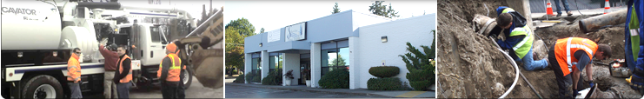
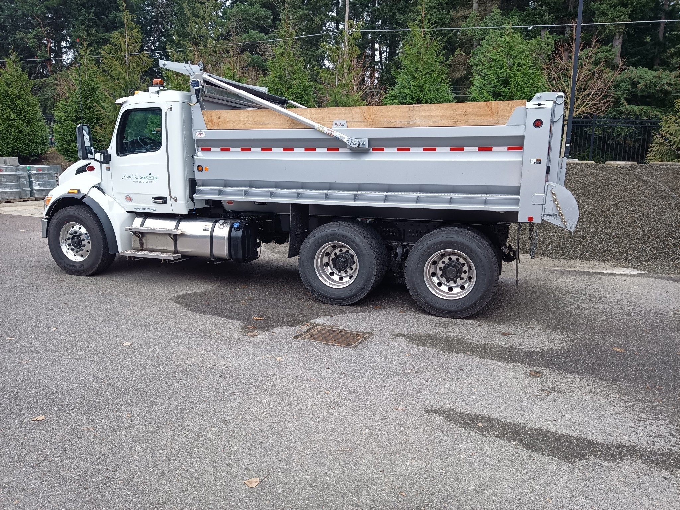
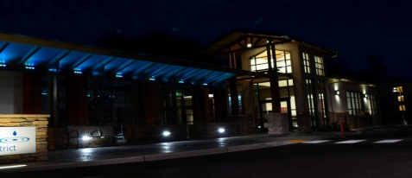
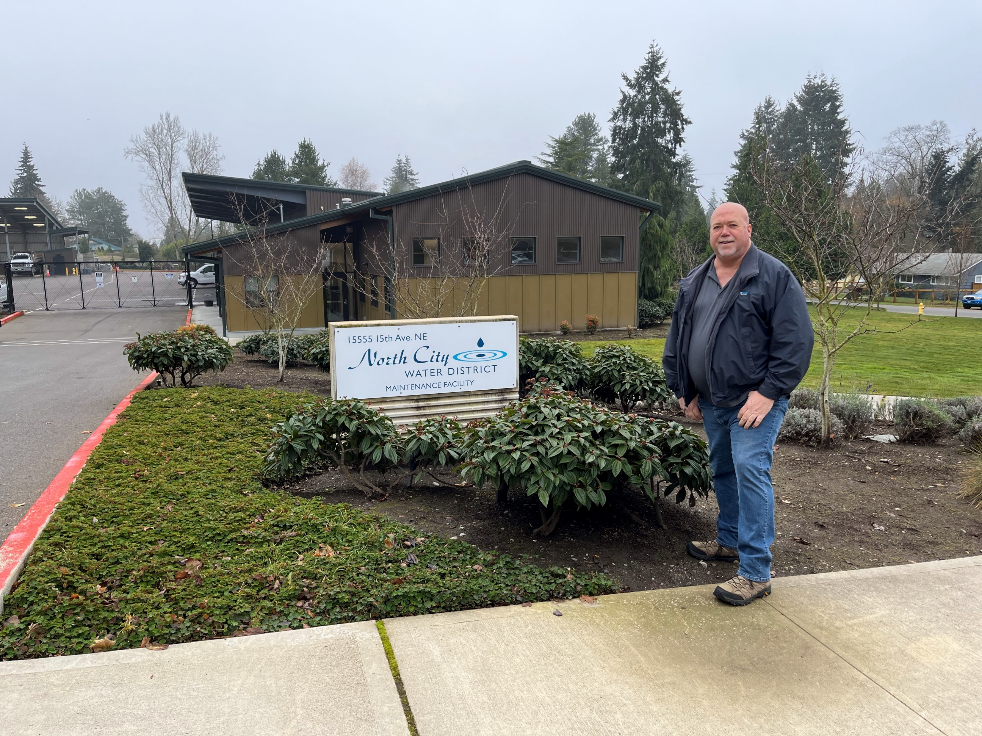
2025
Operating Budget / Actual Presentation
Presentation to the Board of Commissioners
August 5, 2025

Slide 2
Presentation Agenda
  Part 1
  Usage Projections
  Part 2
  Impacts of Changes in Revenue and Costs

Slide 3
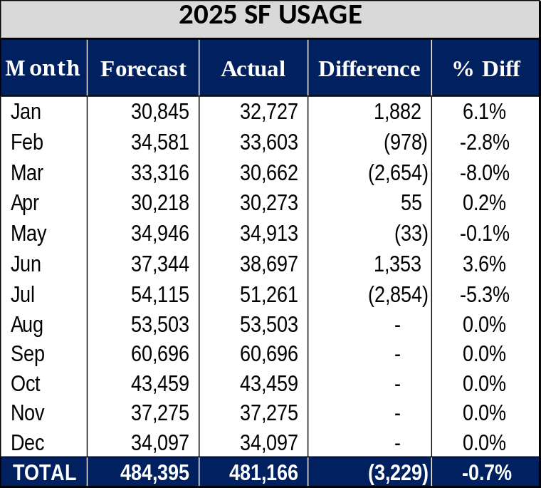
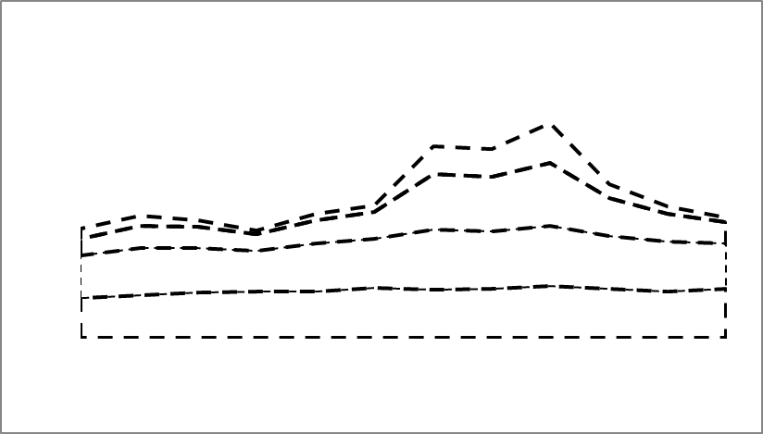
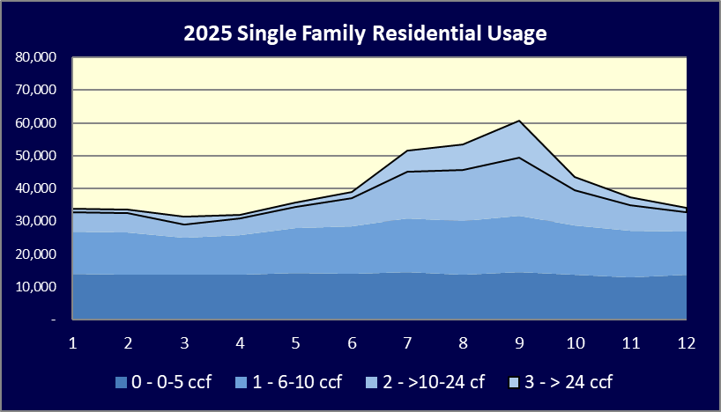
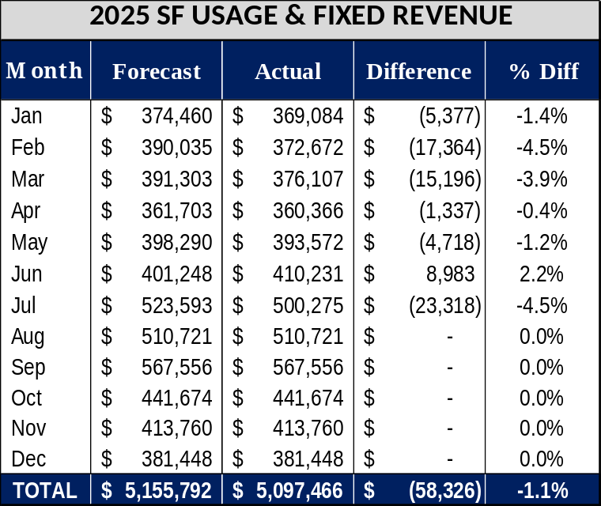
Slide 3
2025 Forecast Usage Compared to Actual Usage – Single Family

Slide 4
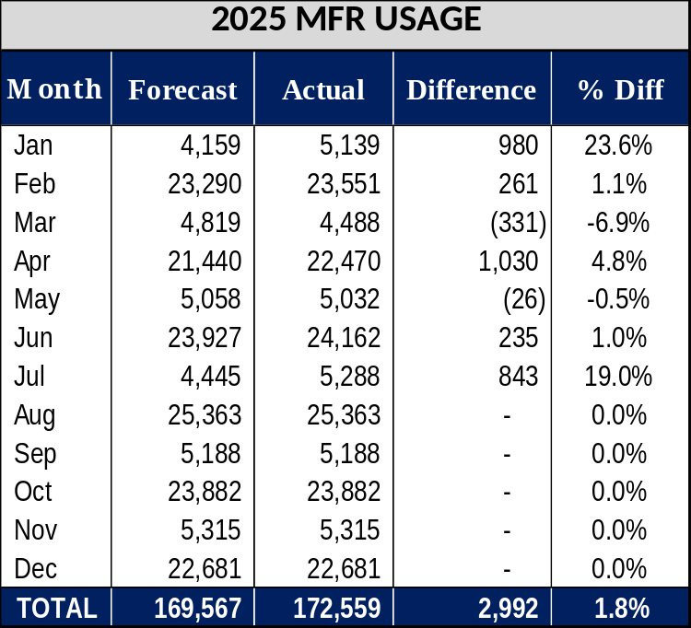
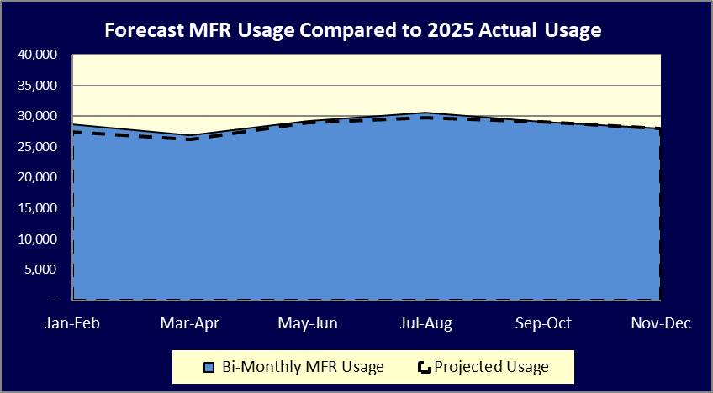
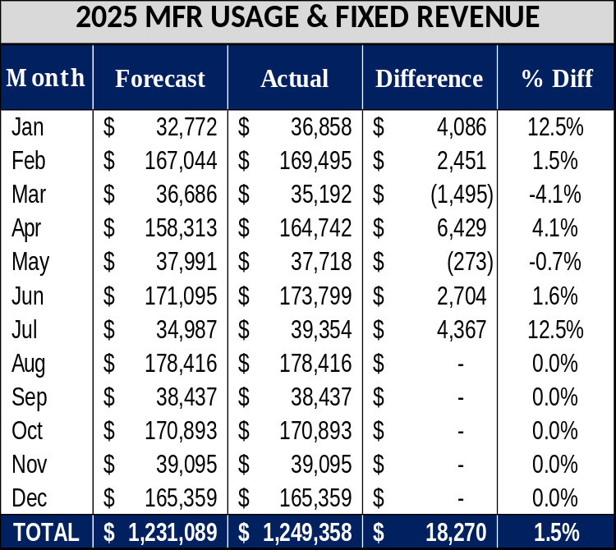
Slide 4
2025 Forecast Usage Compared to Actual Usage – Multi-Family

Slide 5
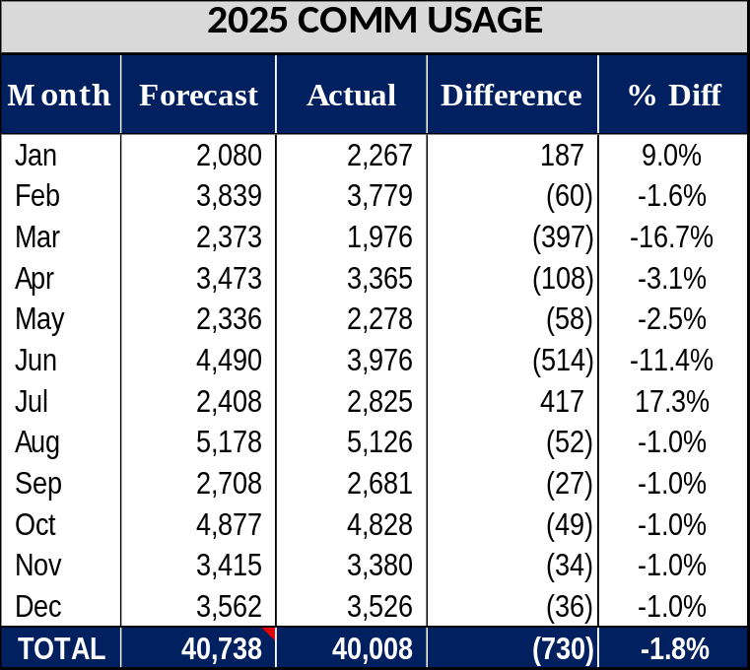

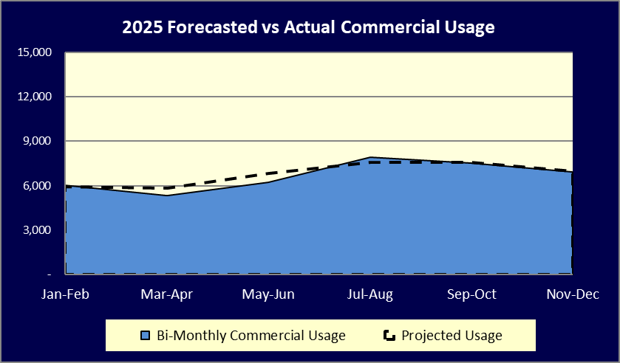
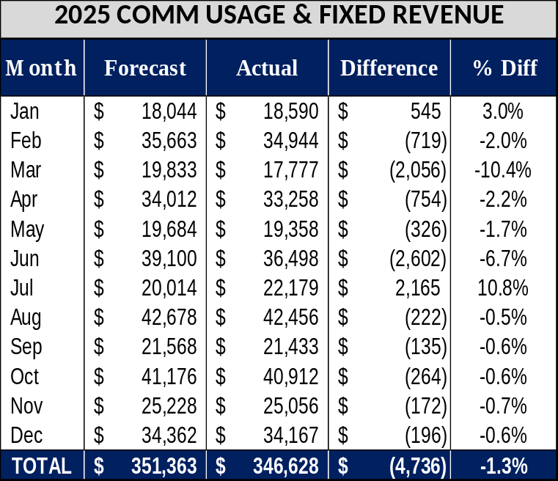
Slide 5
2025 Forecast Usage Compared to Actual Usage – Commercial

Slide 6
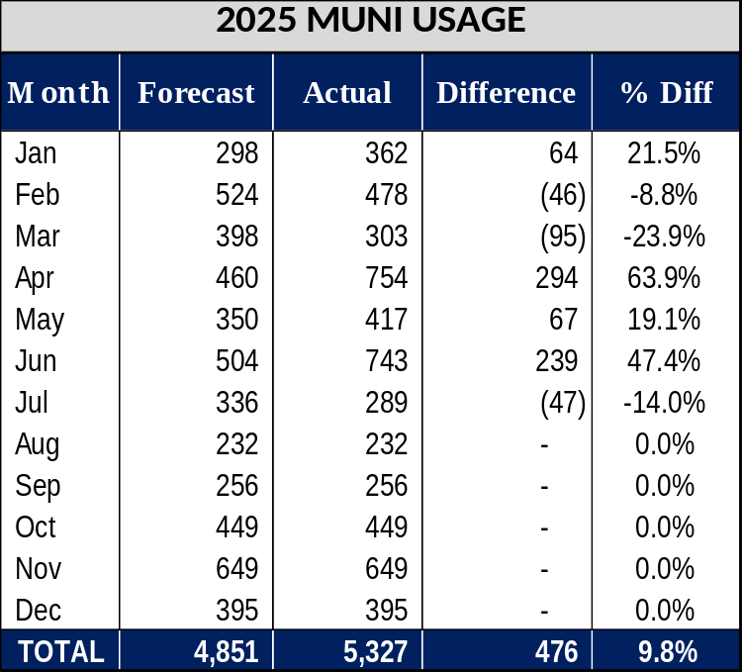
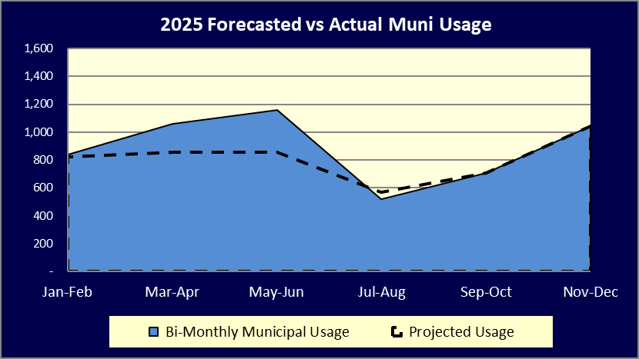
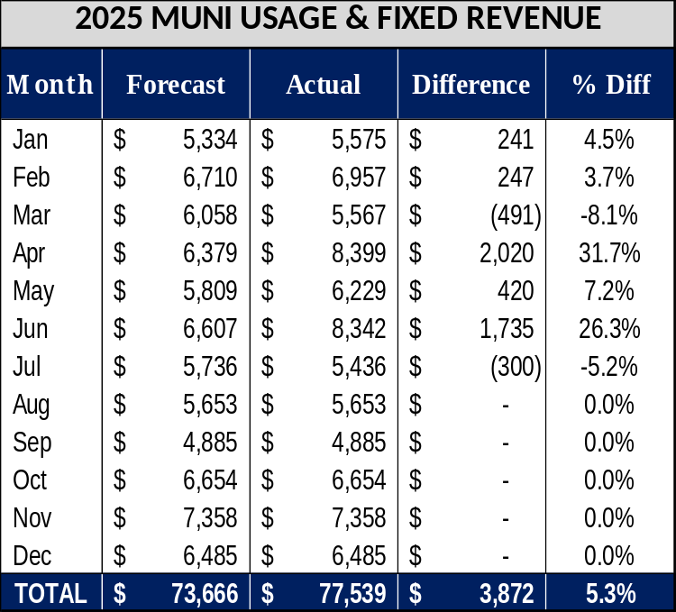
Slide 6
2025 Forecast Usage Compared to Actual Usage – Municipal

Slide 7
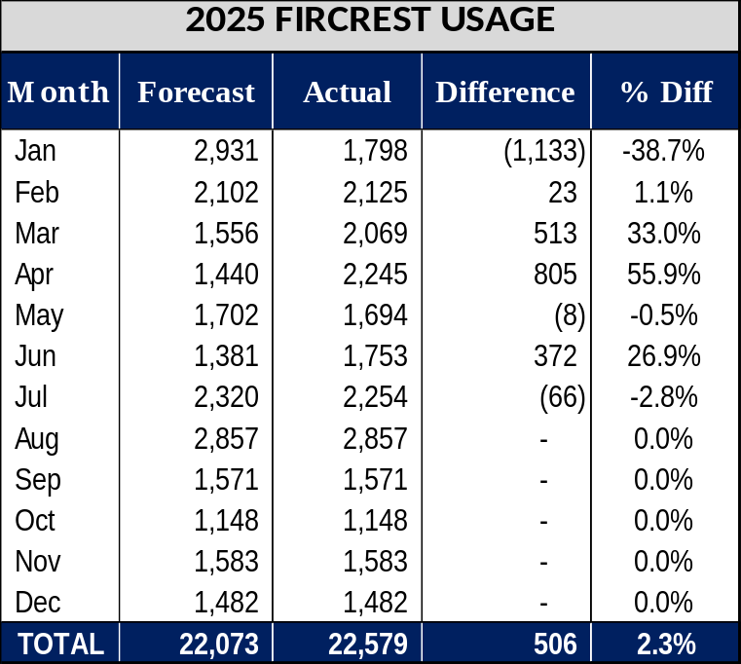
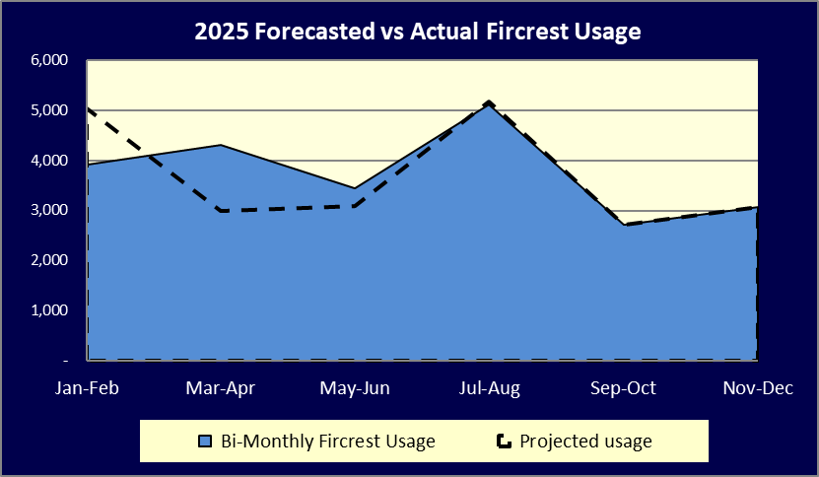
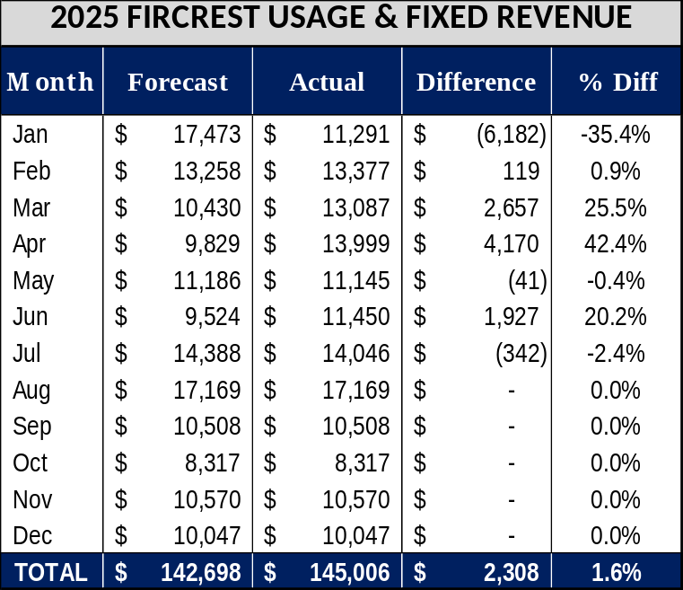
Slide 7
2025 Forecast Usage Compared to Actual Usage – Fircrest

Slide 8
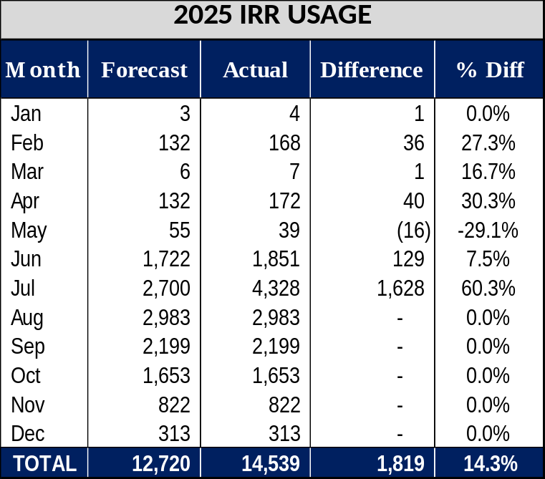
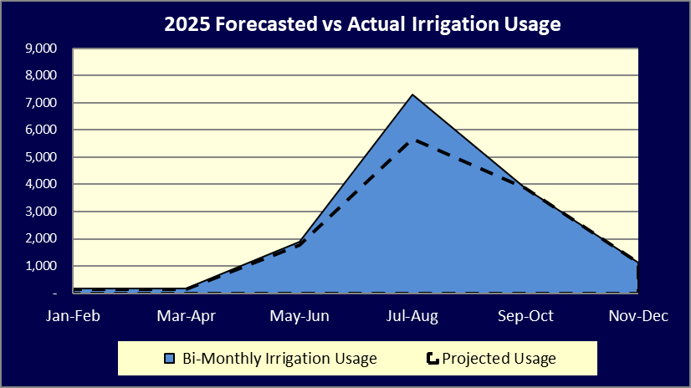
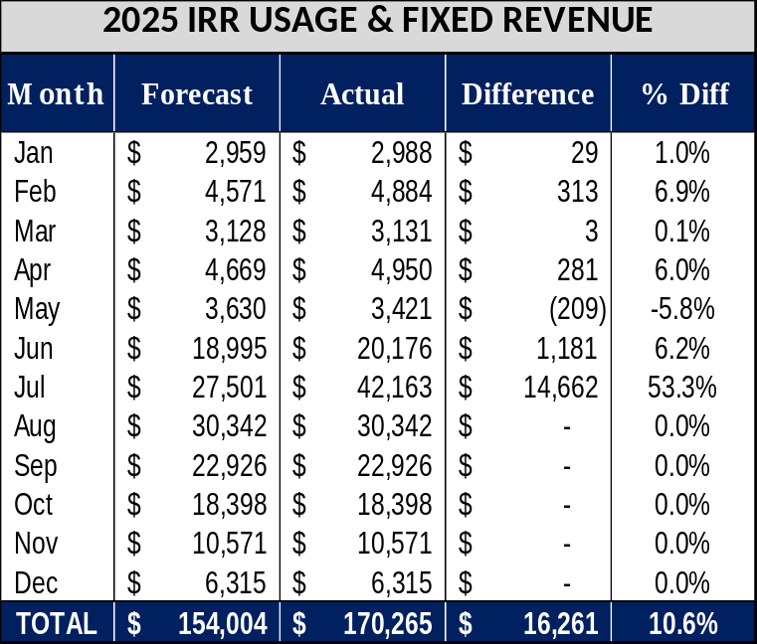
Slide 8
2025 Forecast Usage Compared to Actual Usage – Irrigation

Slide 9
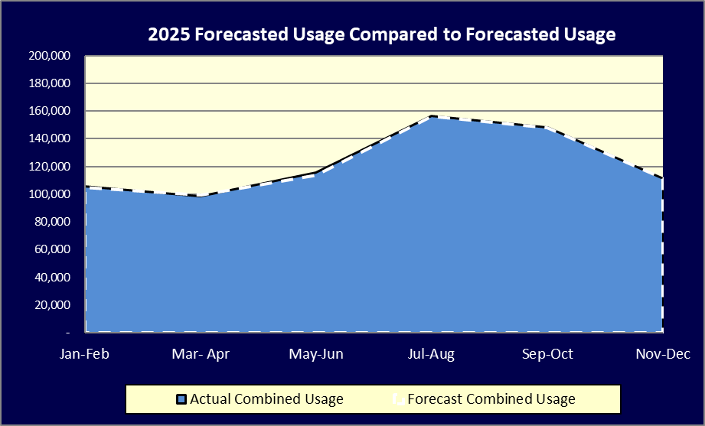
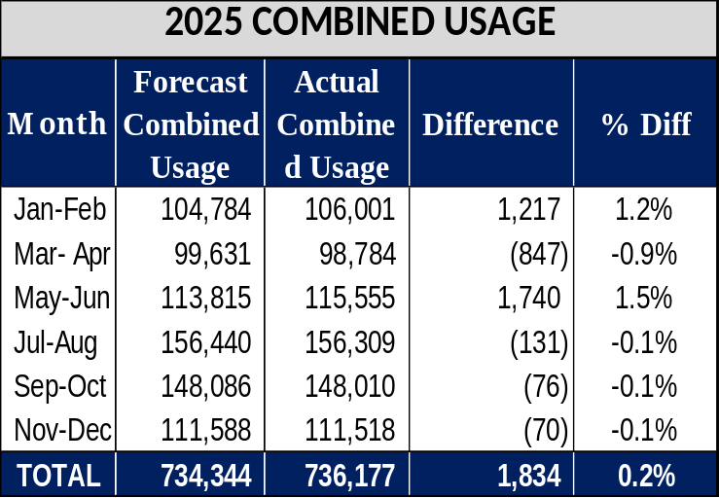
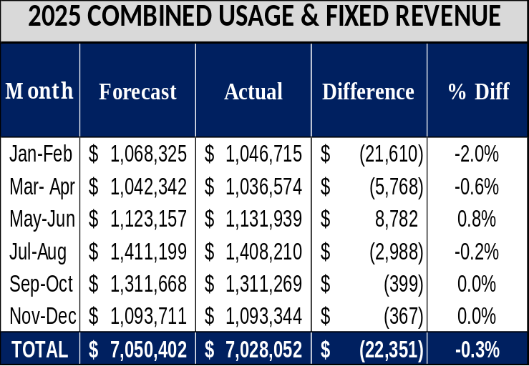
Slide 9
2025 Forecast Usage Compared to Actual Usage – Combined

Slide 10
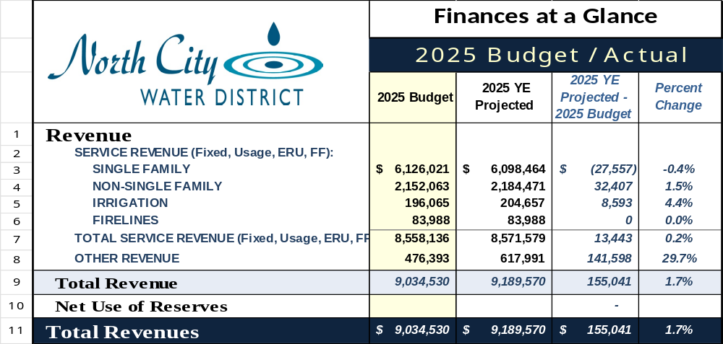
Slide 10
2025 Budget Actual at a Glance

Slide 11
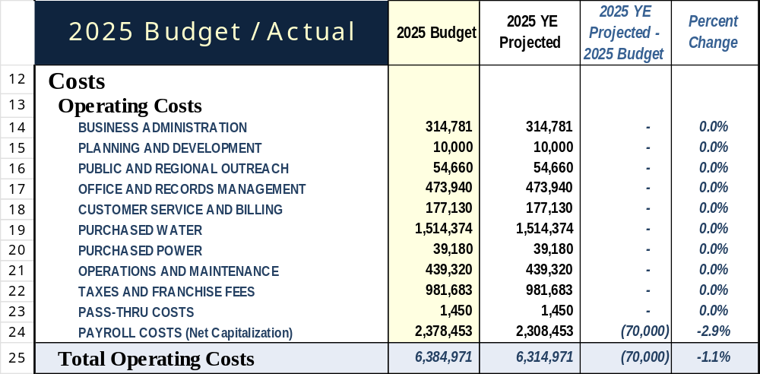
Slide 11
2025 Budget Actual at a Glance

Slide 12
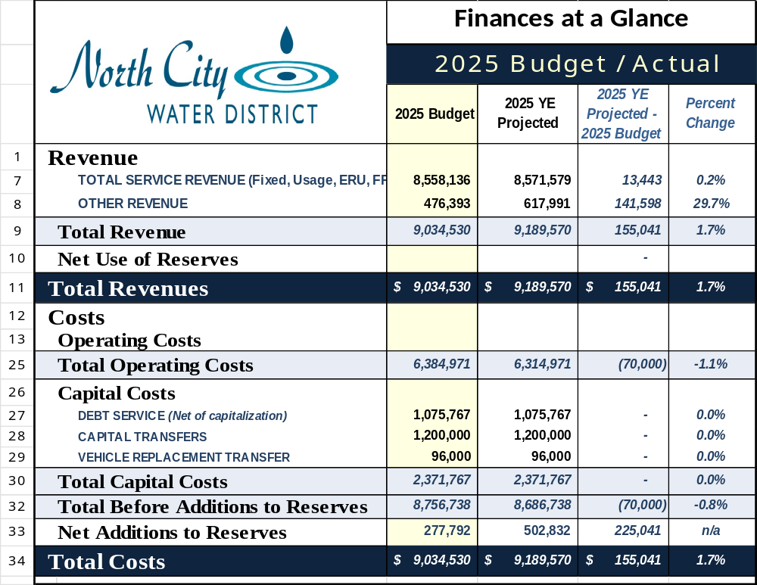
Slide 12

Slide 13
End

